Slide 1
DYNAMIC AUSCULTATION
DR JASSIM KP
SENIOR RESIDENT
DEPARTMENT OF CARDIOLOGY

Slide 2
References
BRAUNWALD’S HEART DISEASE – TWELFTH EDITION
ESSENTIALS OF CARDIAC PHYSICAL DIAGNOSIS – JONATHAN ABRAMS
CLINICAL EXAMINATION IN CARDIOLOGY – B N VIJAY RAGHAWA RAO
CLINICAL METHODS IN CARDIOLOGY – B SOMA RAJU
ESSENTIALS OF POSTGRADUATE CARDIOLOGY

Slide 3
TECHNIQUE OF ALTERING CIRCULATORY DYNAMICS BY PHYSIOLOGICAL AND PHARMACOLOGICAL MANEUVERS AND DETERMINIG THE EFFECTS OF THESE MANEUVERS ON HEART SOUNDS / MURMERS
Notes:
Murmer accentuates during

Slide 4
PHYSIOLOGICAL
- RESPIRATION
- POSTURAL CHANGE
- ISOMETRIC HAND GRIP
- VALSALVA ; MULLERS MANEUVER
PHARMACOLOGIC
-AMYL NITRITE
-PHENYLEPHRINE

Slide 5
RESPIRATION
Inspiration
Vena cava – extra thoracic
Vena caval – right atrial gradient increases
Venous return – increases
Augments right sided events
Left heart –
pulmonary veins are intra thoracic
pulmonary vein- LA gradient doesn’t change
blood gets pooled in lungs
shift of IVS to left →reduced LV preload and stroke volume→ reflex tachycardia
Attenuates left sided events

Slide 6
Inspiration
Increased right heart flow
- increased RV force of contraction
- prolongs RV ejection time
- dilatation of tricuspid annulus
Right sided events increase
P2 delayed – S2 split

Slide 7
Effects on heart sounds
S2- Inspiration - p2 delayed→ S2 split
RVS3 ; RVS4 ; tricuspid OS – inspiration
LVS3 , LVS4 , mitral OS - expiration
Aortic valvular ejection- no variation
LVEDP – no variation
Aortic vascular ES - expiration

Slide 8
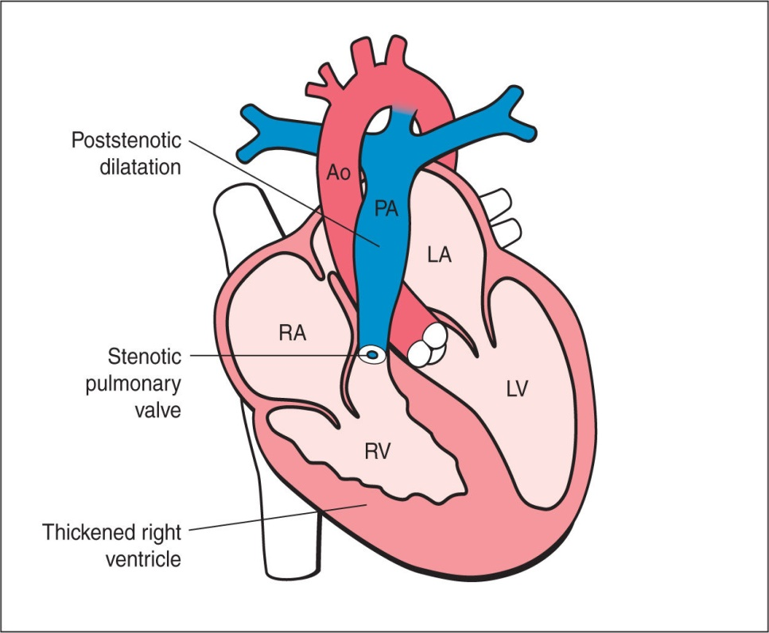
Valvular PS
Phasic ejection click – valves domes up and opens abruptly
- position at onset
- extent of excursion
-
x

Slide 9
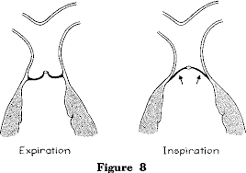
Inspiration
RVEDV
RVEDP
presystolic doming
- Attenuates the click

Slide 10
Effects on heart murmers
Right sided murmers- inspiration
TR – Carvallo sign
Left sided murmers- expiration

Slide 11
MVP
Prolapse of mitral leaflet above annulus during systole
Critical LV volume
Mid- late systole – maximum prolapse
Murmer begins with click and fans out up to A2

Slide 12
Inspiration – decrease in LV size and stroke volume
Any maneuver which decrease LV size
Decrease - LVEDP
Early attainment- critical volume
Prolapse early in systole
Click moves closer to S1
Murmer becomes longer

Slide 13
No variation in
pulmonary HTN
severe right heart failure

Slide 14
Postural Change
Sudden lying down
Venous return → RV stroke volume
LV stroke volume and LV size - after several cardiac cycles
Effect on heart sound
RVS3 , RVS4 , LVS3 , LVS4

Slide 15
Effect on heart murmer
Stroke volume- RV & LV
LVEDV & LV size
Increases systolic murmers of
PS
AS
MR
TR
VSD
Functional systolic murmers
Click and murmer of MVP- delayed and attenuated
Murmer of HOCM diminished-- pressure gradient decrease

Slide 16
HOCM
Murmer starts after S1
Crescendo -decrescendo pattern.
Dynamic obstruction of LVOT
systolic increase in thickness bulge in LV cavity of
already hypertrophied septum
systolic anterior motion (SAM) of anterior mitral
leaflet

Slide 17
Any factor which decreases LV size- LVEDV –Decreased preload
Decreased afterload
Increased contractility
Increase murmur of HOCM

Slide 18
Standing from supine position
venous return decreases . ps

Slide 19
Passive leg raising
Venous return to right heart increases in initial few cycles- accentuates right sided events

Slide 20
Squatting
venous return → SV
Increase in central aortic pressure → bradycardia
SVR increases due to kinking of iliac arteries and reduction of distending pressure of gravity on lower limb vessels
All events- accentuated
Except- HOCM , MVP , pulmonary click of valvular PS

Slide 21
Increased venous return and SV- augments
Systolic murmers of PS , AS
Diastolic murmer of TS and MS
Increase in aortic reflex
Diastolic murmer of AR audible and augmented
Elevated SVR and systemic pressure
Increases regurgitant volume – systolic murmer of MR
Elevated SVR – TOF
right to left shunt is decreased with increased pulmonary blood flow
Alleviates symptoms and augments intensity of systolic murmer

Slide 22
Increased LV size- VR and arterial pressure
Decreases LVOTO in HCM
Little or no prolapse in MVP

Slide 23
Left lateral recumbent position
Closeness of heart to chest wall
Transient increase in HR
Accentuates – S1 , LVS3 , LVS4 and Mitral OS
Accentuates- MDM of MS, austin flint murmer , SM of MR

Slide 24
Sitting up and leaning forward
Base of heart- close to chest wall
Loud P2 and split S2 - more clearly audible
DM of AR and PR more clearly audible

Slide 25
Knee elbow position
heart – close to chest wall
Pericardial rub – increased friction between pericardial layers

Slide 26
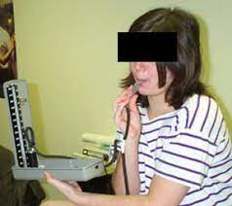
valsalva
Forced expiration against closed glottis
40mmhg for 30 secs

Slide 27
valsalva
Phase 1
Transfers the high intrathoracic pressure to the intrathoracic structures
Passive raise in BP
Squeezes the pulmonary venous blood to left heart- mild increase in stroke volume
Insignificant change in pulse pressure and heart rate

Slide 28
Phase 2
Sustained pressure
Decrease in venous return
Decrease in stroke volume
Reduced BP and pulse pressure
Reflex tachycardia- sympathetic
All- attenuated ; A2-P2 narrows
except – MVP / HCM

Slide 29
LV volume and size – reduces
LVOTO - pressure gradient
augments HCM murmer
prolapse – loud and early click and murmer

Slide 30
Phase 3
Cessation of straining
Incease in VR
Abrupt, transient decrease in arterial pressure equivalent to fall in intrathoracic pressure
First 2 cycles- right sided events return to normal
After 6-8 cycles- left side events return to normal

Slide 31
Phase 4
Venous return and force of contraction increase→ increase in stroke volume
Rise in BP – overshoot the baseline value- reflex bradycardia ….. Vagal response

Slide 33
Muller’s maneuver
Forced inspiration against closed glottis
Exaggerates inspiratory effort
Right sided events augmented

Slide 34
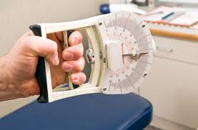
Isometric hand grip
Increases
- systemic vascular resistance
- heart rate
- cardiac output
- BP
-LV filling pressure and size
all left sided events increase 20-30secs
Except- MVP ; AS ; HOCM

Slide 35
AS-
increased arterial pressure & SVR
decreased gradient across AV
Increased LV volume and size
HCM - gradient
MVP – click and murmer delayed

Slide 36
Changes in cardiac cycle length
PVC
Compensatory pause
longer cycle lengths-AF
ventricular filling and ventricle size
ventricuar contractility- next beat
Transient – arterial pressure

Slide 37
ESM of AS and PS
- ventricular filling
- ventricular contractility
HOCM -
- contractility - LVOT obstruction
- volume – LVOT obstruction
net - gradient

Slide 38
Increased ventricular filling and LV size
- click and murmer of MVP delayed
Diastolic murmer of AR – louder- transient elevation of arterial pressure
Systolic murmer of MR and VSD – no change
relatively little change in LV-LA gradient

Slide 39
Amyl nitrite
Reduces systemic vascular resistance ; BP→ first 30 secs
Increases HR , contractilty, CO , flow rate→ 30-60secs

Slide 40
CO increases - augments
- Systolic murmer of AS, PS , TR
- all functional systolic murmers
- diastolic murmer of MS , TS , PR

Slide 41
Decreased SVR – diminishes
Systolic murmer of MR , small VSD
- diastolic murmer of AR
Austin flint murmer of AR
-diastolic phase of continuous murmer of PDA

Slide 42
Systolic murmer of TOF – diminishes
Decreased SVR and arterial pressure
- increases right to left shunt
Decreases pulmonary blood flow

Slide 43
S1 augmented
A2 diminished
Arterial pressure falls –
mitral and tricuspid OS – louder
A2 –OS interval decreases
Rapid ventricular filling – RVS3 & LVS3 augments
MR reduced- LVS3 associated with MR diminished

Slide 44
Systolic murmer | AS | MR
Systolic murmer | TR | MR
Systolic murmer | PS | TOF
Systolic murmer | PS | VSD
Diastolic murmer | MS | Austin flint
EDM | PR | AR

Slide 45
Methoxamine and phenylephrine
methoxamine
phenylephrine
3-5 mg IV
Elevates arterial pressure – 20-40mmhg
10-20 mins
0.3-0.5mg IV
Elevates arterial pressure by 30mmhg
3-5 mins
preferred

Slide 46
Opposite of Amyl nitrate
Increases arterial pressure
Reflex bradycardia
Decreased contractility and CO

Slide 47
Increased arterial pressure –
Louder murmers of
- EDM –AR
- PSM –MR
- VSD -TOF -continuous murmer of PDA and AVF

Slide 48
Decreased CO - Diminishes
- ESM –AS
- MDM-MS
- functional systolic murmer
Increased LV size
HOCM murmer softens
click and murmer of MVP delays

Slide 49
Mitral stenosis
INSPIRATION SUDDEN STANDING
pulmonary venous return
LAP
MDM reduced
OS softens
A2-OS widens
A2-P2-OS audible
EXERCISE
SQUATTING
AMYL NITRATE
MDMaccentuated

Slide 50
Mitral regurgitation
Sudden standing
Valsalva
Amyl nitrite
Attenuate murmer
Squatting
Isometric exercise
Augments murmer

Slide 51
Aortic stenosis
Valsalva
Hand grip
Standing
Diminishes murmer
Squatting
Post PVC beat
Augments murmer

Slide 52
Aortic regurgitation
Squatting
Isometric exercise
Sitting and leaning forward
Vasopressors
Augments murmer
Amyl nitrate
Valsalva
Diminishes murmer

Slide 53
MVP
LV volume decreased
Murmer and click earlier
Standing
valsalva
LV volume increased
Murmer and click later
Squatting
Post ectopic
Isometric exercise ( intensity increase)

Slide 54
HCM
Valsalva
Standing
Post ectopic
Murmer augments
Squatting
Isometric handgrip
Methoxamine
Diminishes murmer

Slide 56
MCQs
During squatting ,
Venous return decreases
Systemic vascular return decreases
Aortic reflex decreases
LV size increases

Slide 57
Increased LV size causes
Decrease in LVOTO in HCM
Early click in MVP
Early murmer of MVP
Both 2 and 3

Slide 58
Inspiration augments all , except
Murmer of TR
RVS3
TRICUSPID OS
Click of valvular PS

Slide 59
Vagal response occurs in which phase of valsalva
Phase 1
Phase 2
Phase 3
Phase 4

Slide 60
During amyl nitrite inhalation
systolic murmer of TOF diminishes
Systolic murmer of AS diminishes
Systolic murmer of PS diminishes
Diastolic murmer of MS diminishes

Slide 61
Thank you

